Slide 1
Predictive Modeling
Chapter 11: Measuring Performance in Classification Models
STA 6543
The University of Texas at San Antonio

Slide 2
Overview
Part I: General Strategies
Part II: Regression Models
Chapter 5: Measuring Performance in Regression Models
Chapter 6: Linear Regression and Its Cousins
Chapter 7: Nonlinear Regression Models
Chapter 8: Regression Trees and Rule-Based Models
Part III: Classification Models
Chapter 11: Measuring Performance in Classification Models
Chapter 12: Discriminant Analysis and Other Linear Classification Models
Chapter 13: Nonlinear Classification Models
Chapter 14: Classification Trees and Rule-Based Models

Slide 3
An overview of classification
Classification problems occur when the response variable is qualitative, which takes values in a discrete set C. For instance,
default ϵ {yes, no};
eyecolor ϵ {brown, blue, green}
Given a training data set D_{training} = {(x_{i} , y_{i})} for i = 1,…,n, we want to build a classifier C(x) that assigns a class label from C to a future unlabeled input vector x.
The logistic regression
The Bayes classifier
The linear discriminant analysis
K-nearest neighbors
etc

Slide 4
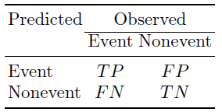
Confusion matrix
The confusion matrix is a common method for describing the performance of a classification model. The confusion matrix for the two-class problem is
The table cells indicate number of the true positives (TP), false positives (FP), true negatives (TN), and false negatives (FN)
Diagonal cells denote cases where the classes are correctly predicted while the off-diagonals illustrate the number of errors for each possible case.

Slide 5
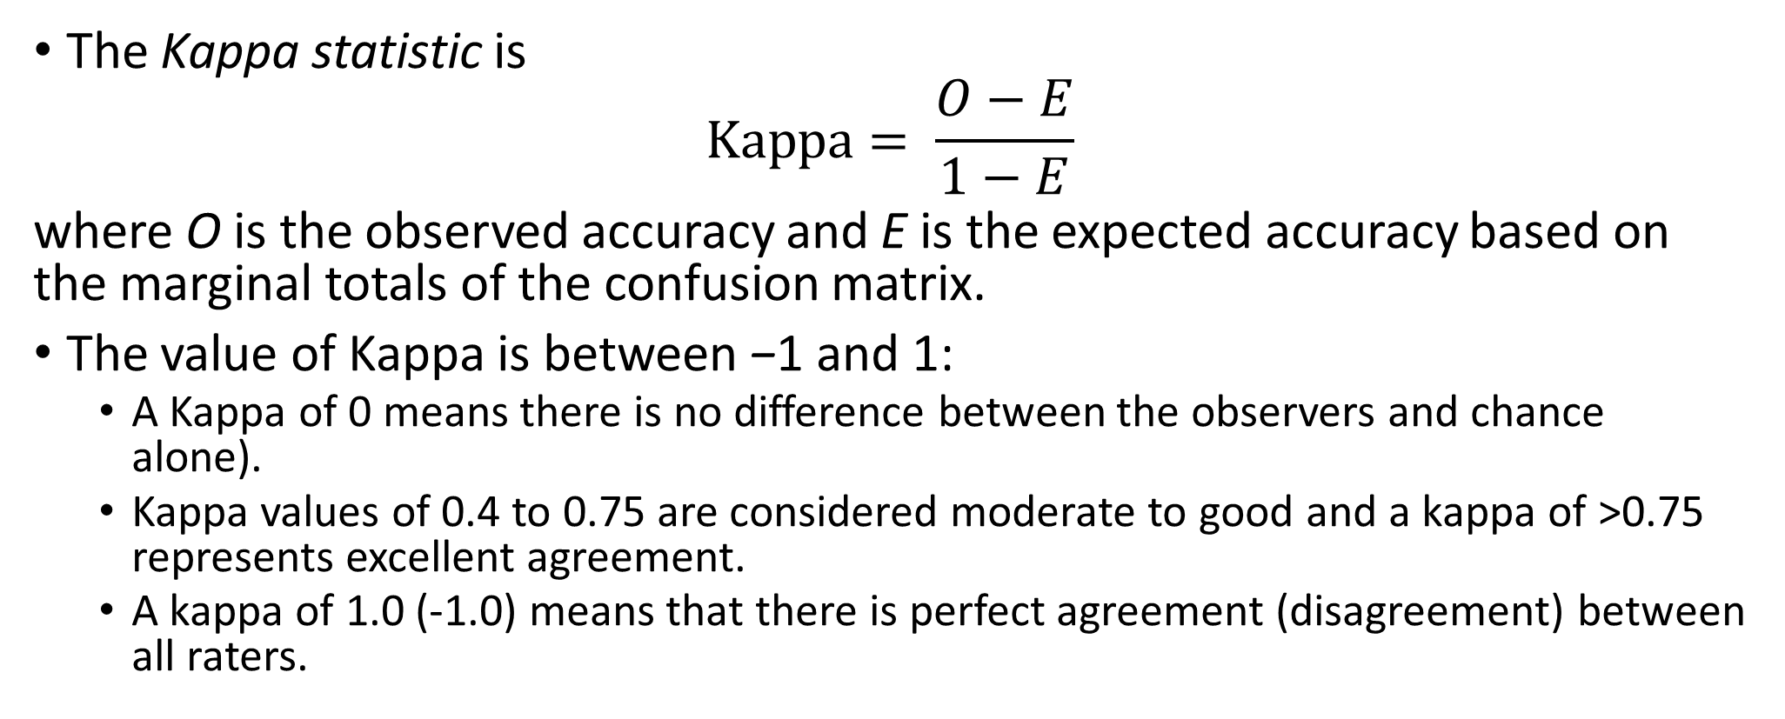
Evaluating predicted classes
The Kappa statistic is
$$Kappa= \frac{O−E}{1−E}$$
where O is the observed accuracy and E is the expected accuracy based on the marginal totals of the confusion matrix.
The value of Kappa is between −1 and 1:
A Kappa of 0 means there is no difference between the observers and chance alone).
Kappa values of 0.4 to 0.75 are considered moderate to good and a kappa of >0.75 represents excellent agreement.
A kappa of 1.0 (-1.0) means that there is perfect agreement (disagreement) between all raters.

Slide 6

Two-class problems
The sensitivity of the model (i.e., the true positive rate) is the rate that the event of interest is predicted correctly for all samples having the event, or
The specificity (i.e, 1 - the false-positive rate) is defined as the rate that nonevent samples are predicted as nonevents, or

Slide 7
Two-class problems
There is typically a trade-off to be made between the sensitivity and specificity.
Increasing the sensitivity of a model is likely to incur a loss of specificity, since more samples are being predicted as events.
Potential trade-offs between sensitivity and specificity may be appropriate when there are different penalties associated with each type of error.
In spam filtering, there is usually a focus on specificity; most people are willing to accept seeing some spam if emails from family members or coworkers are not deleted.

Slide 8
The receiver operating characteristic (ROC)
The ROC is one technique for evaluating the trade-off between the sensitivity and specificity.
The ROC curve can be used for determining alternate cutoffs for class probabilities.

Slide 9
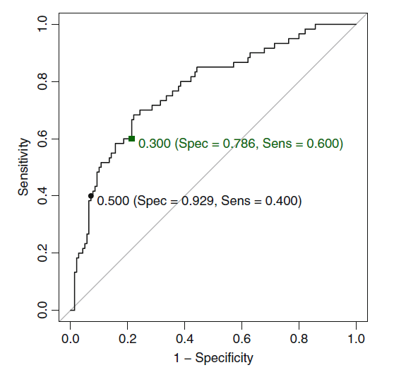
The ROC curve for the logistic regression model results for the credit model
Can we improve the sensitivity by lowering the threshold5 to capture more true positives (TP)?

Slide 10
Remarks of the ROC curve
This plot is a helpful tool for choosing a threshold that appropriately maximizes the trade-off between sensitivity and specificity.
We see from the plot that decreasing the threshold begins to capture more of the customers with bad credit but also begins to encroach on the bulk of the customers with good credit.
The model with the largest area under the ROC curve would be the most effective.

Slide 11
Example
library(AppliedPredictiveModeling) library(randomForest) ### Simulate some two class data with two predictors set.seed(975) training <- quadBoundaryFunc(500) testing <- quadBoundaryFunc(1000) testing$class2 <- ifelse(testing$class == "Class1", 1, 0) testing$ID <- 1:nrow(testing) #Scatter plot xyplot(X1~ X2, groups=class, data=training)

Slide 12
Example

Slide 13
Example
### Fit three models: QDA, RM, Logistic #QDA library(MASS) qdaFit <- qda(class ~ X1 + X2, data = training) #RM library(randomForest) rfFit <- randomForest(class ~ X1 + X2, data = training, ntree = 2000) #Logistic glmFit <- train(class ~ X1 + X2, data = training, method = "glm", trControl = trainControl(method = "repeatedcv“, repeats = 5)) ### Predict the test set based on three models testing$qda <- predict(qdaFit, testing)$posterior[,1] testing$rf <- predict(rfFit, testing, type = "prob")[,1] testing$glm <- predict(glmFit, testing, type = "prob")[,1]

Slide 14
Example
### Create the confusion matrix from the test set. #Confusion Matrix of qda Fit confusionMatrix(data = predict(qdaFit, testing, type = "prob")$class, reference = testing$class) #Confusion matrix of random forest confusionMatrix(data = predict(rfFit, testing), reference = testing$class) #Confusion matrix of logistic confusionMatrix(data = predict(glmFit, testing), reference = testing$class)

Slide 15
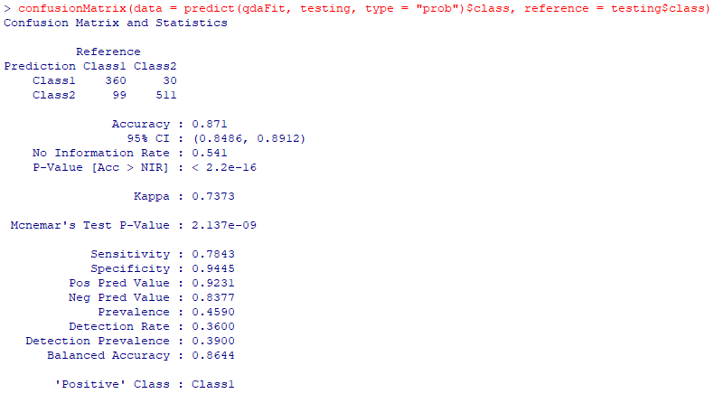
Confusion Matrix of qdaFit

Slide 16
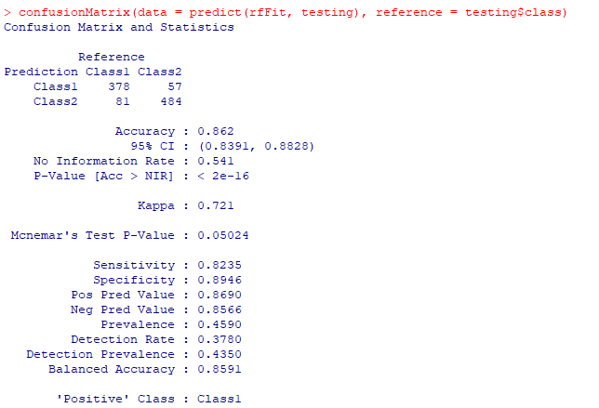
Confusion matrix of random forest

Slide 17
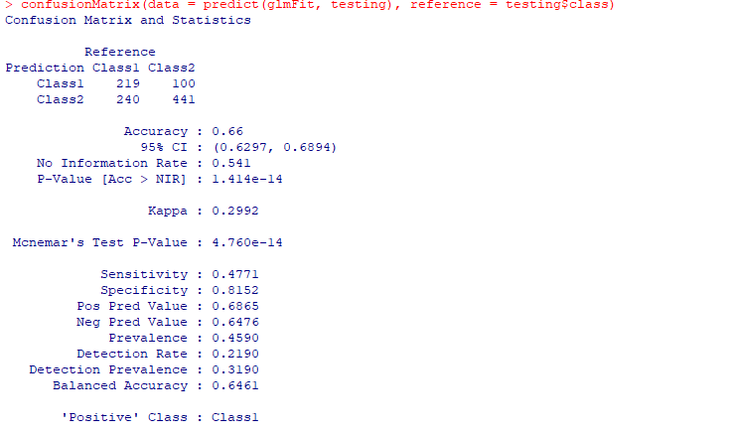
Confusion matrix of logistic

Slide 18
ROC curves
### ROC curves: ### Like glm(), roc() treats the last level of the factor as the event ### of interest so we use relevel() to change the observed class data library(pROC) #ROC for QDA qdaROC <- roc(testing$class, testing$qda) plot(qdaROC, col=1, lty=1) #ROC for Random forest rfROC <- roc(testing$class,testing$rf) lines(rfROC, col=2, lty=2) #ROC for GLM glmROC <- roc(testing$class, testing$glm) lines(glmROC, col=3, lty=3) legend('bottomright', c('QDA','RF','GLM'), col=1:3, lty=1:3,lwd=2)

Slide 19
The calibration plot

